Slide 1
Aakash Goel https://www.linkedin.com/in/goelaakash123/
Session 7:
SIFT (Scale Invariant Feature Transform)
Acknowledgement: Slide Materials adopted from - Intro to Computer Vision (Cornell Tech); Noah Snavely, prepared by the lead instructor Prof S P Vimal , modified (added some content) by Aakash Goel

Slide 2
SIFT - What
SIFT (Scale Invariant Feature Transform) Detector is used in the detection of interest points on an input image. It allows the identification of localized features in images which is essential in applications such as:
Object Recognition in Images
Path detection and obstacle avoidance algorithms
Gesture recognition, Mosaic generation, etc.

Slide 3
Motivation - SIFT
Why do we need something like SIFT?
In real-world images, objects may:
Appear at different scales (near vs. far),
Be rotated,
Be partially occluded,
Be taken under different lighting conditions.
We need feature descriptors that are:
Invariant to scale and rotation,
Robust to illumination and partial occlusion.

Slide 4
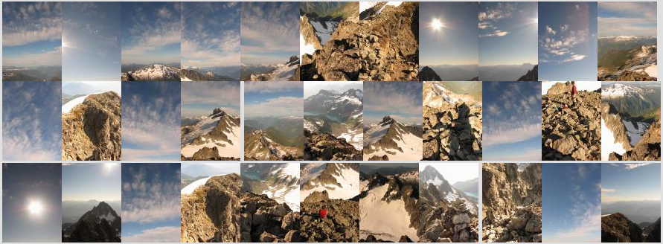
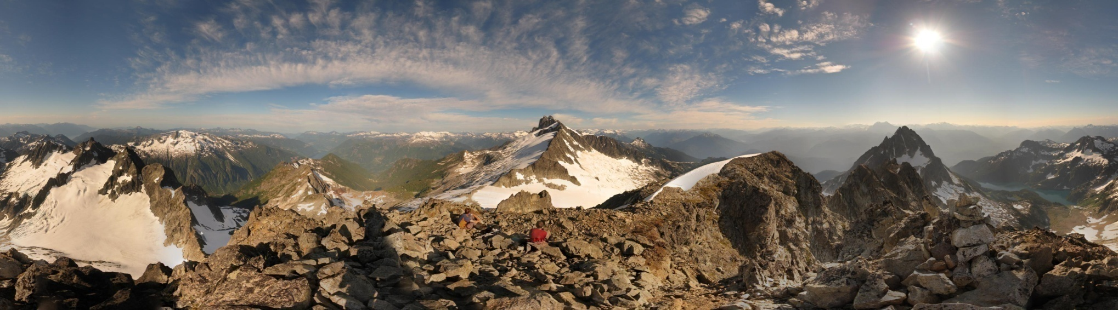
Motivation: Automatic panoramas
Credit: Matt Brown

Slide 5


Why extract features?
Motivation: panorama stitching
We have two images – how do we combine them?
Panorama stitching is the process of combining multiple overlapping images into a single wide-angle image. For example, when you take several pictures of a landscape by rotating your phone and want them stitched together into one seamless photo.

Slide 6


Why extract features?
Motivation: panorama stitching
We have two images – how do we combine them?
Step 1: extract features
Step 2: match features

Slide 7

Why extract features?
Motivation: panorama stitching
We have two images – how do we combine them?
Step 1: extract features
Step 2: match features
Step 3: align images

Slide 8
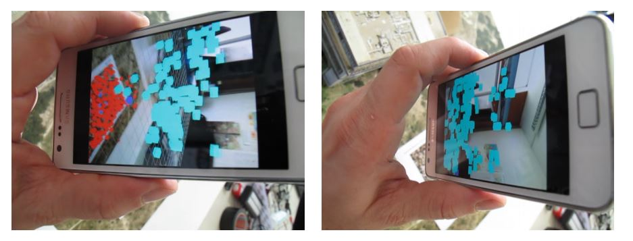
Application: Visual SLAM
(aka Simultaneous Localization and Mapping)

Slide 9
Visual SLAM
It's a technique used by robots, drones, and AR devices to:
Map the environment (build a 3D model or layout),
Localize themselves in that environment (figure out where they are),
All at the same time, and using only camera(s) (no GPS).
Think of it this way:
Imagine you're dropped in a dark unknown room with just a flashlight (your camera). You move around slowly and take pictures.
From these pictures:
You build a map of the room,
You also figure out your position in the room with each step.
That's Visual SLAM.

Slide 10
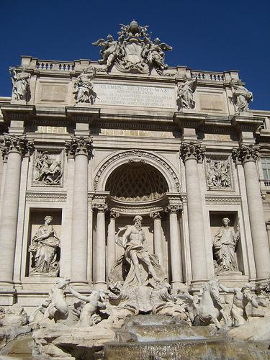
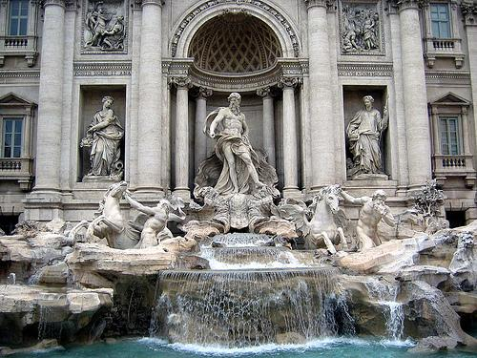
Image matching
Image Matching is the process of finding corresponding points (or regions) between two or more images that may depict the same scene, object, or pattern—but under different conditions.
by Diva Sian
by swashford

Slide 11
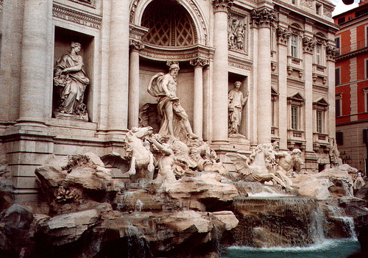
Harder case
by Diva Sian
by scgbt
Matching an image taken at a different angle, under different lighting, and at a different distance.
SIFT extracts keypoints and descriptors that are still matchable under all these variations.

Slide 12


Feature matching for object search
Application of feature matching in identifying and locating objects within different contexts

Slide 13


Feature Matching
zooms in on the matched features from both images, showing how specific patterns or textures are identified and matched. This highlights the precision of feature matching in recognizing and locating objects based on distinct visual features, even when the object is part of a larger, more complex scene.

Slide 14
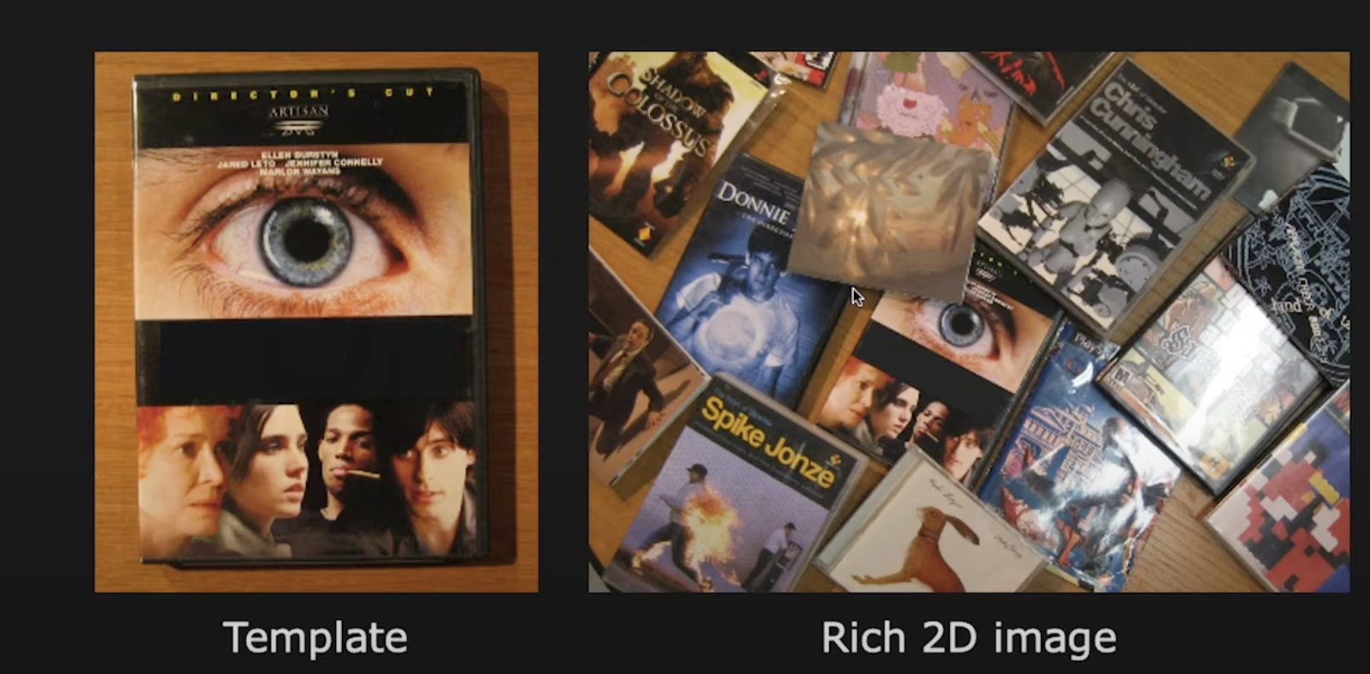
Object matching
Object matching using a template image.
Left image serves as a template, showing a specific object (a DVD cover), while the right image contains a cluttered scene with multiple objects, including the one from the template. The goal is to use feature matching techniques to identify and locate the template object within the complex scene

Slide 15
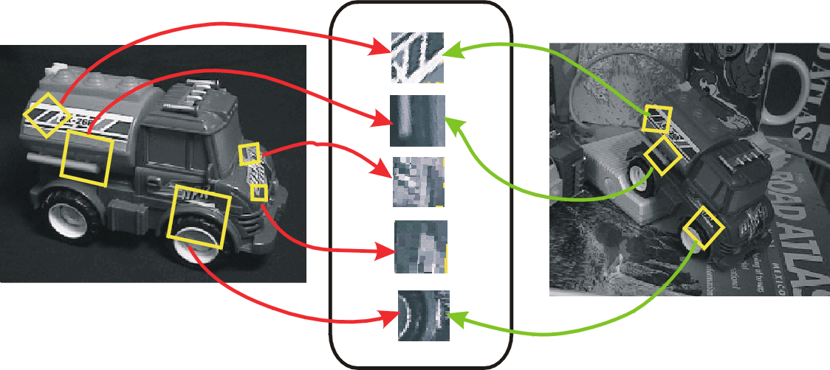
Invariant local features
CV 7: Scale Invariant Feature Transform
Find features that are invariant to transformations
geometric invariance: translation, rotation, scale
photometric invariance: brightness, exposure, …
Feature Descriptors

Slide 16
Advantages of local features
Locality
features are local, so robust to occlusion and clutter because they focus on small, distinct parts of an image, allowing for reliable detection even when parts of the object are hidden or surrounded by other objects.
Quantity
A single image can contain hundreds or thousands of local features, providing a rich set of data points for analysis and matching
Distinctiveness:
enabling the differentiation of objects within a large database
Efficiency
real-time performance achievable

Slide 17
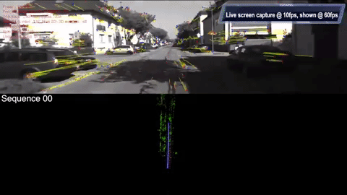
More motivation…
Feature points are used for:
Image alignment (e.g., mosaics)
3D reconstruction
Motion tracking (e.g. for AR)
Object recognition
Image retrieval
Robot/car navigation
… other

Slide 18
Approach
1. Feature detection: find it, identifying and locating distinctive features within an image. The goal is to find keypoints that are stable and can be reliably detected across different images.
2. Feature descriptor: represent it, Once features are detected, they are represented using descriptors. These descriptors capture the local image information around each keypoint, allowing for a unique and compact representation of the feature
3. Feature matching: match it, the descriptors are used to match corresponding features between different images. This is crucial for tasks like image alignment, object recognition, and 3D reconstruction.
4. Feature tracking: track it, when motion, feature tracking involves following the detected features across a sequence of images. This is important for applications such as video analysis and motion detection.

Slide 19
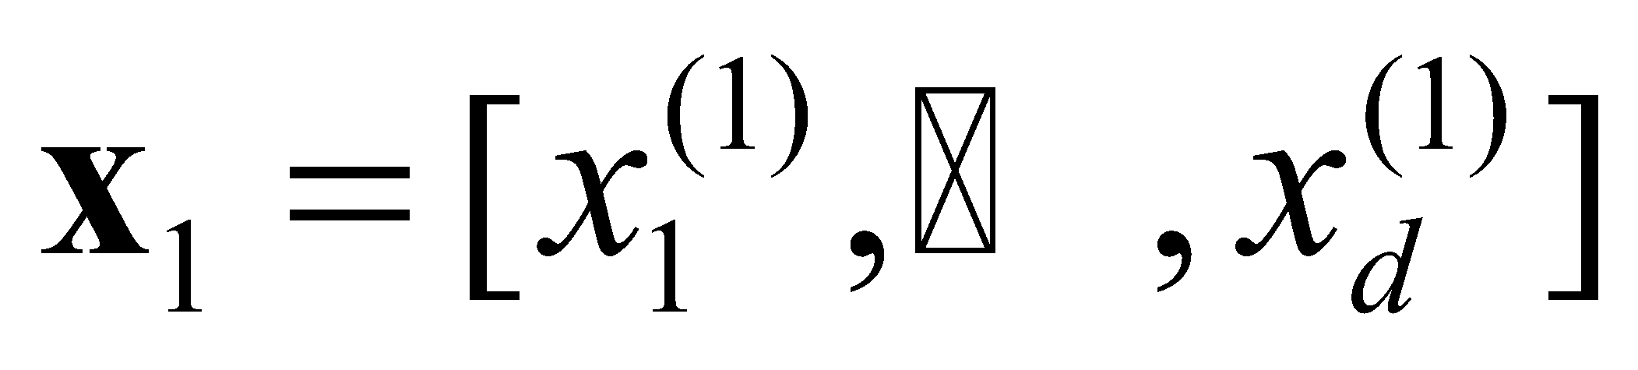
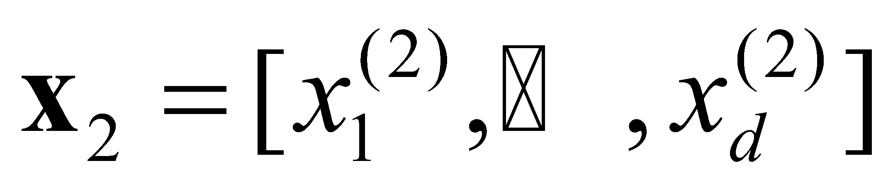
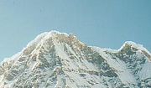
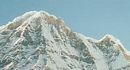
Local features: main components
Detection: Identify the interest points, which are distinctive and stable features that can be reliably detected across different images. (Technique: SIFT, Harris Corner Detector)
Description: Extract vector feature descriptor surrounding each interest point. These descriptors capture the local image information around the interest points, providing a unique representation. (Technique: histogram of gradient orientations)
Matching: Determine correspondence between descriptors in two views. matching the descriptors from one image to those in another, enabling tasks like image alignment and 3D reconstruction. (Technique: distance metrics like Euclidean distance or cosine similarity + RANSAC to filter out incorrect matches.)
Credit: Kristen Grauman

Slide 20
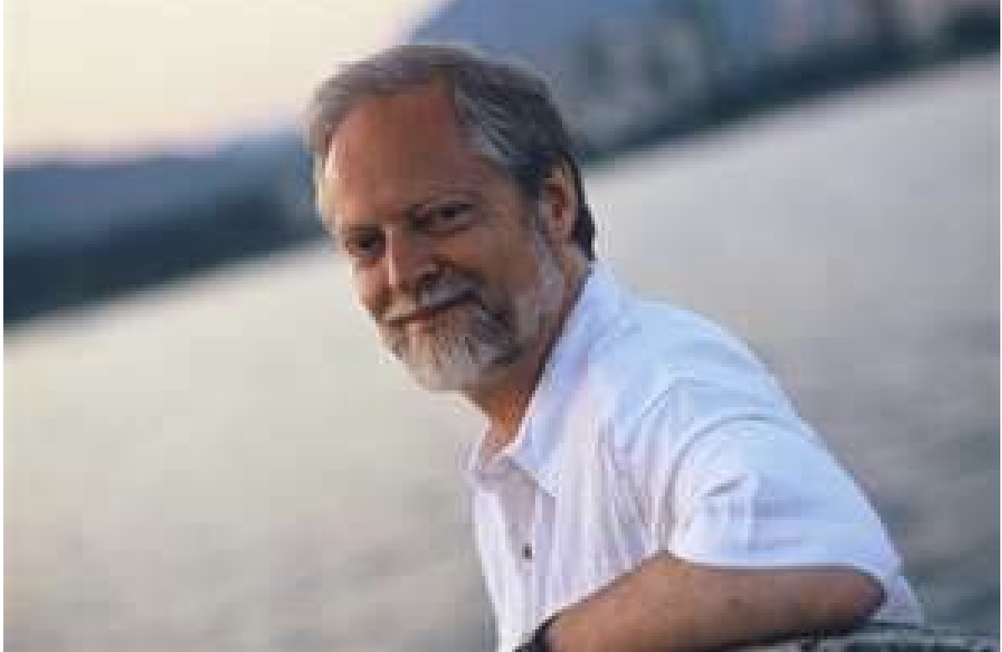
SIFT - Key point Extraction
Stands for scale invariant feature transform
Patented by university of British Columbia
Similar/mimics to the one used in primate visual system (human, ape, monkey, etc.)
Transforms image data into scale invariant coordinates, allowing it to detect features that remain consistent despite changes in scale, making it robust for various applications like object recognition and image matching.
David Lowe, UBC
D. Lowe. Distinctive image features from scale-invariant key points., International Journal of Computer Vision 2004.

Slide 21
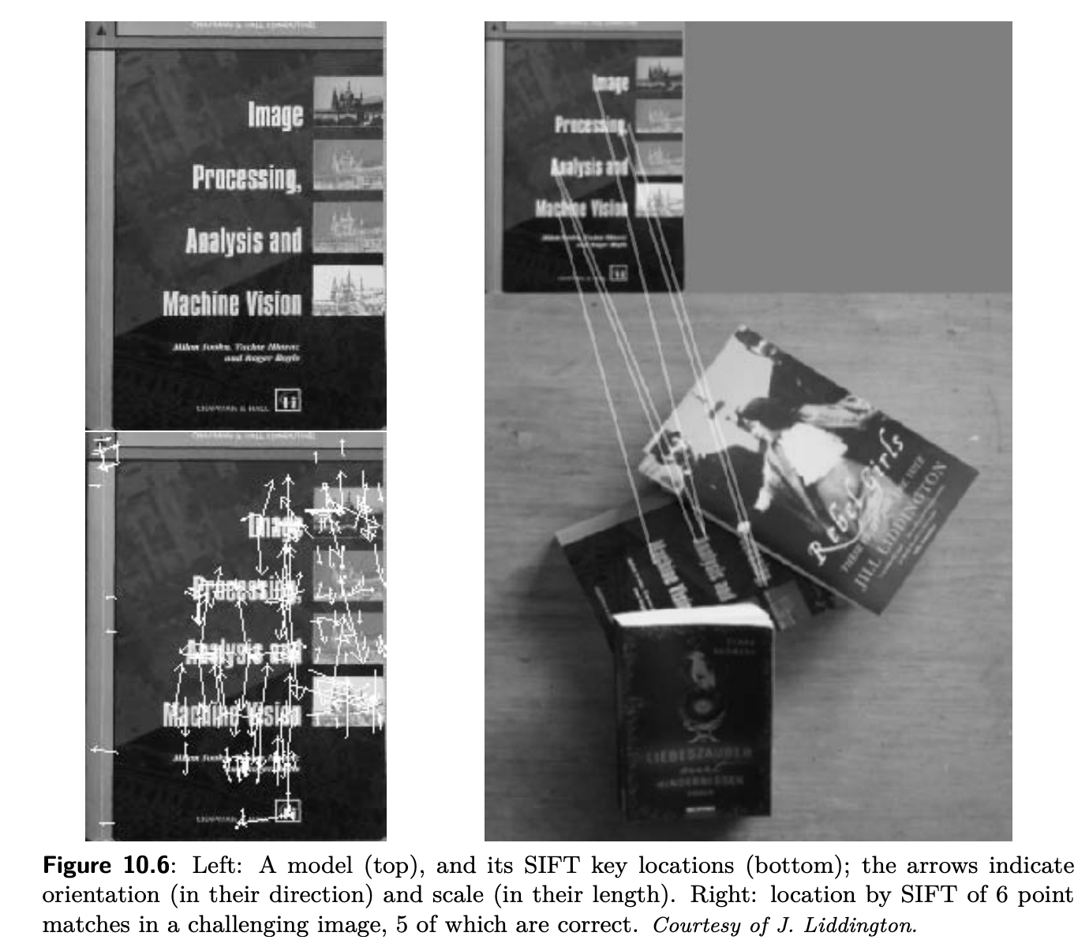
SIFT
SIFT Algorithm intuition
An analogy for understanding the SIFT algorithm is to think of it like a detective identifying and matching fingerprints at a crime scene:
Keypoint Detection: Imagine the detective is looking for fingerprints at a scene. These fingerprints are like the keypoints in an image—distinctive and unique patterns that stand out from the rest of the surface.
Descriptor Representation: Once a fingerprint is found, the detective analyzes its unique ridges and patterns, creating a detailed record. This is similar to how SIFT creates a descriptor for each keypoint, capturing the local image details.
Feature Matching: The detective then compares the recorded fingerprints with those in a database to find matches. Similarly, SIFT compares descriptors from different images to identify corresponding features, even if the fingerprints (or features) are smudged or partially visible.

Slide 22
Goal
Extracting distinctive invariant features
Correctly matched against a large database of features from many images
Invariance to image scale and rotation
Robustness to
Affine distortion,
Change in 3D viewpoint,
Addition of noise,
Change in illumination.

Slide 23
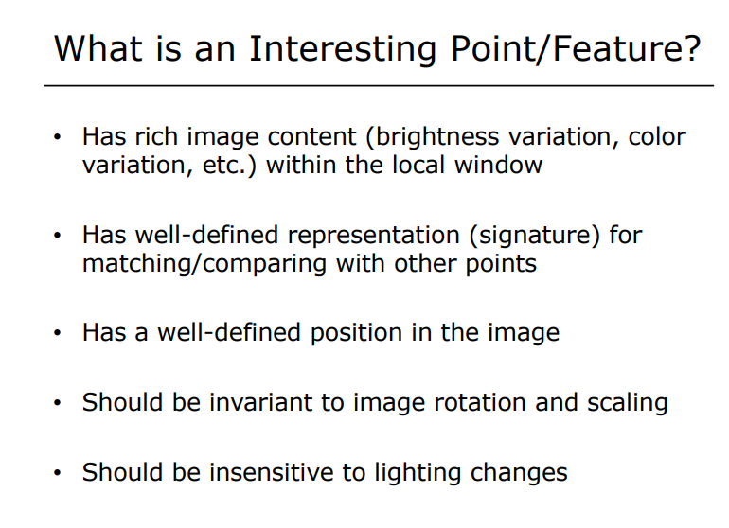

Slide 24
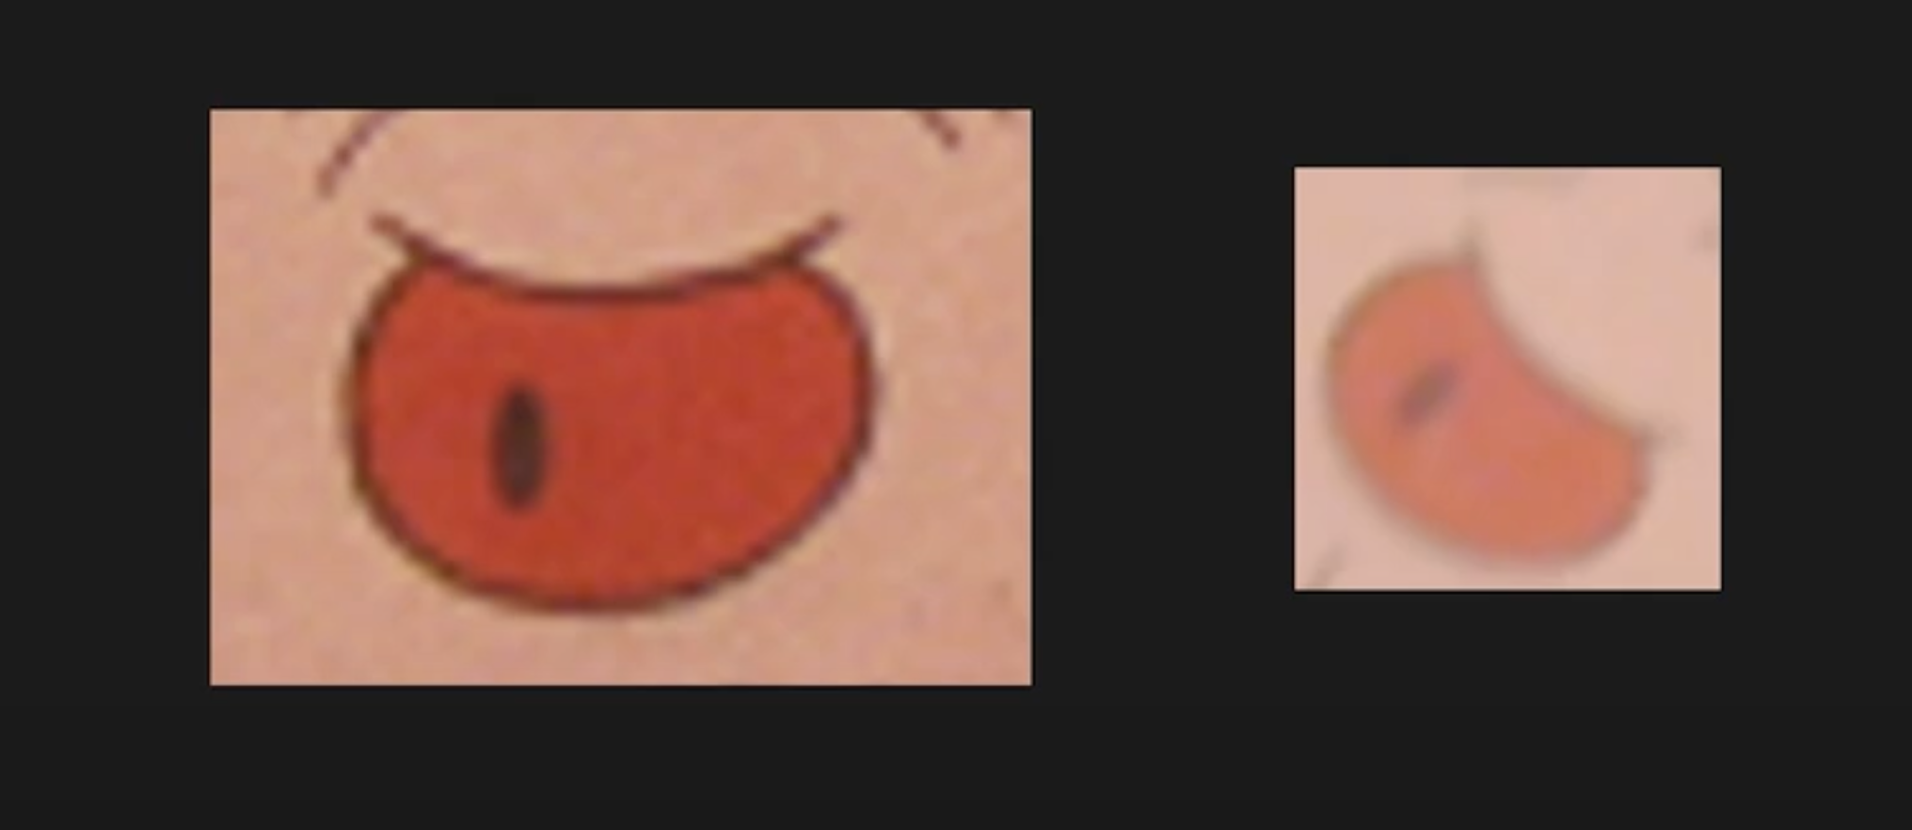
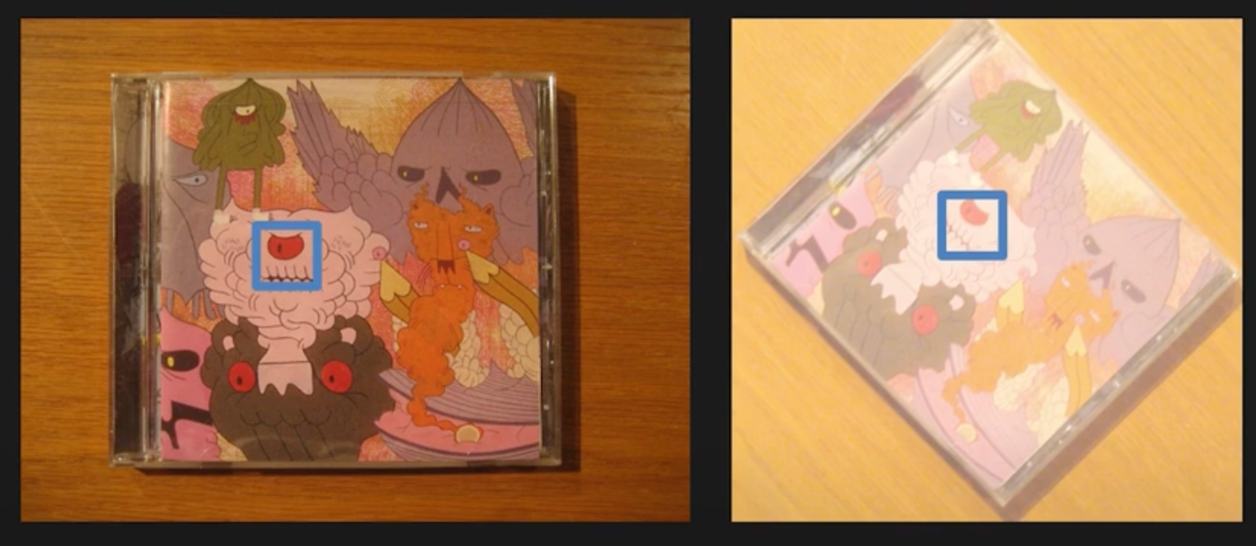
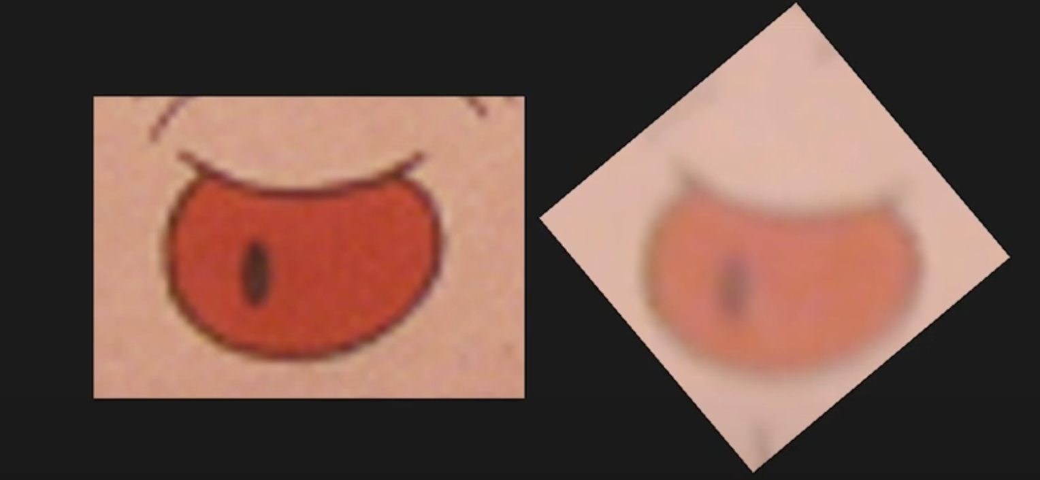
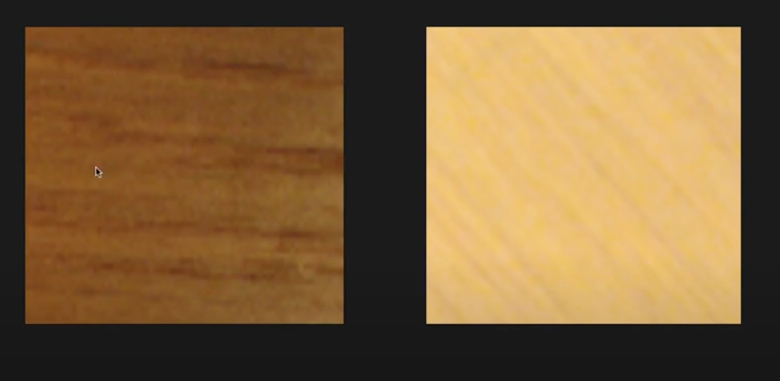
Raw image matching

Slide 25
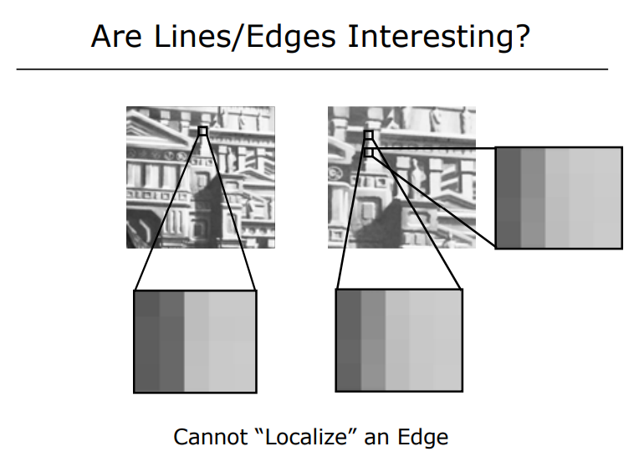

Slide 26
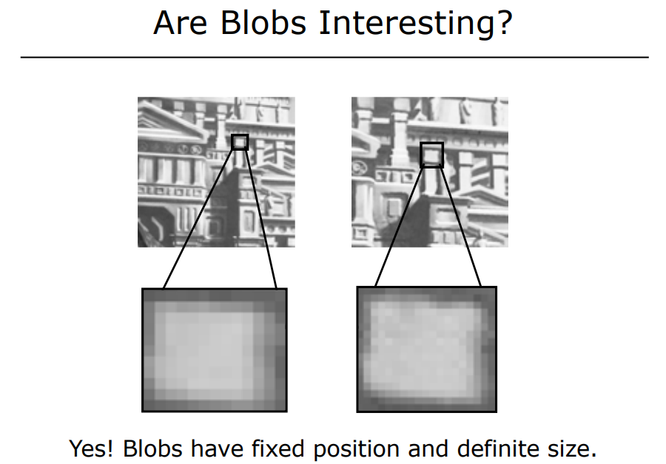
A blob is a patch or area of interest in an image that is identified at different scales. The term "blob" is used loosely to describe a patch with a local appearance is essentially a region in the image characterized by significant intensity changes, detected via scale-space analysis and refined for robustness

Slide 27
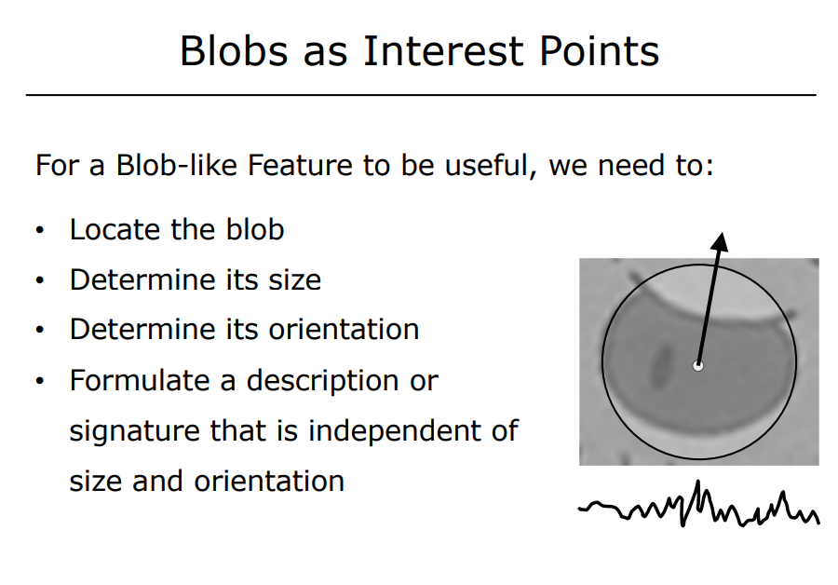

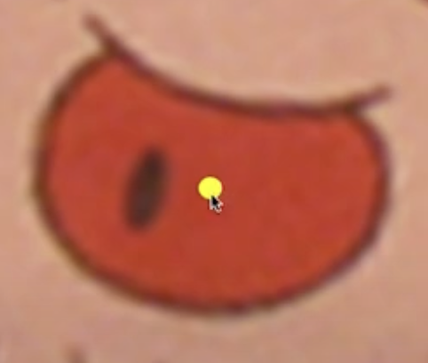
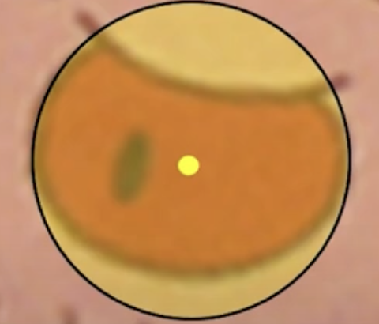

Slide 28
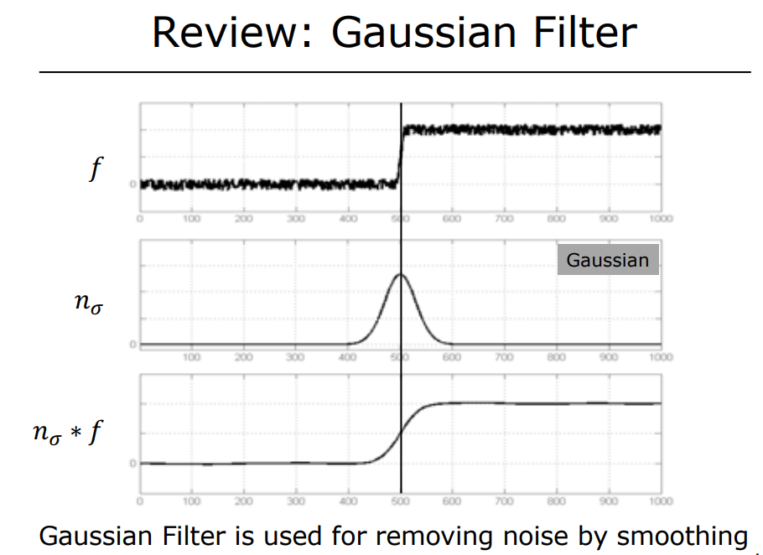

Slide 29
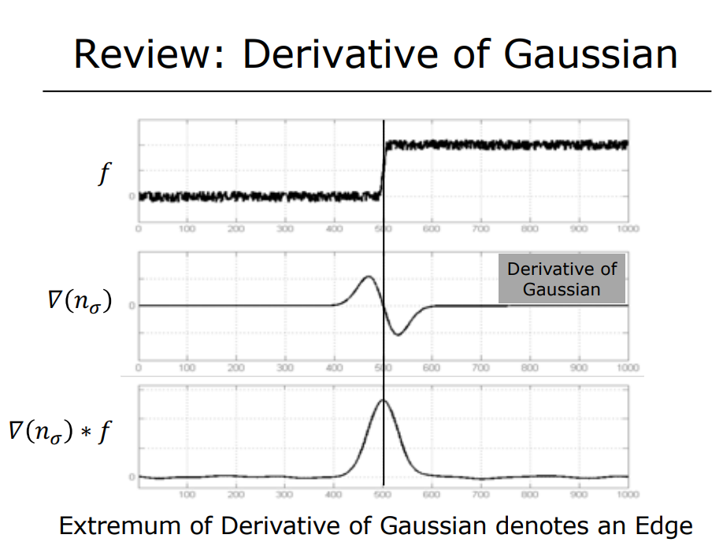

Slide 30
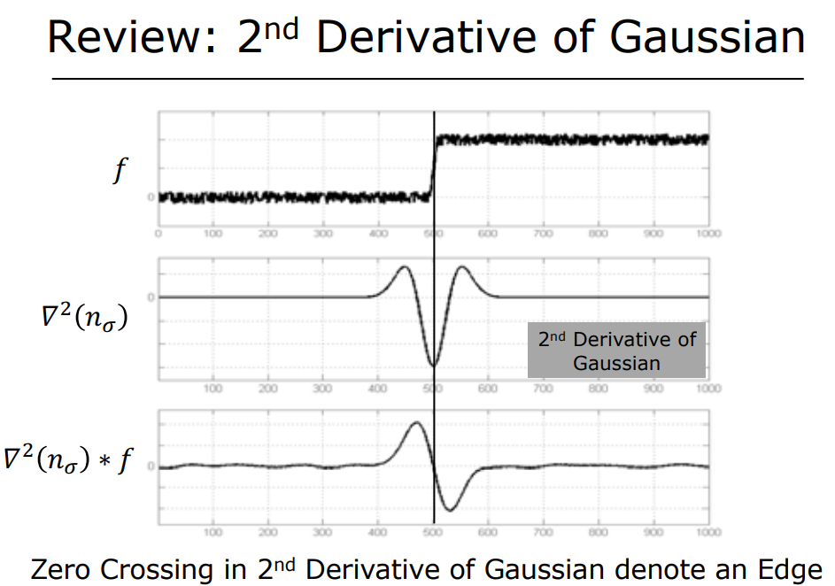

Slide 31
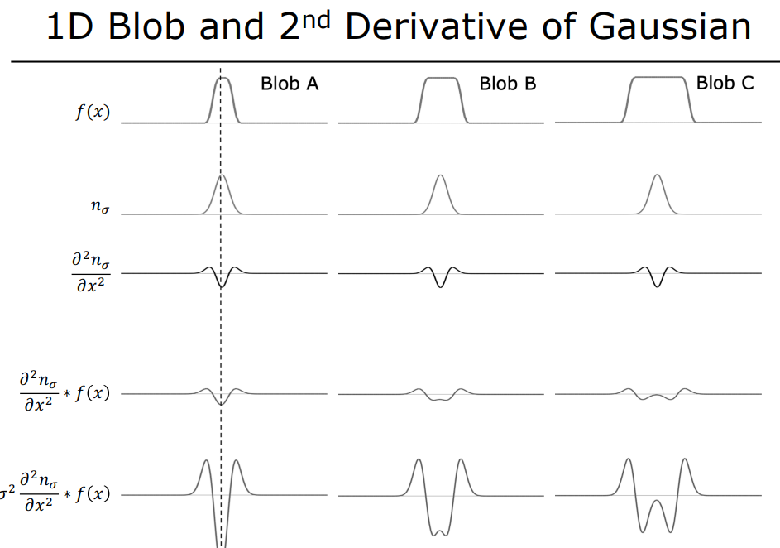

Slide 32
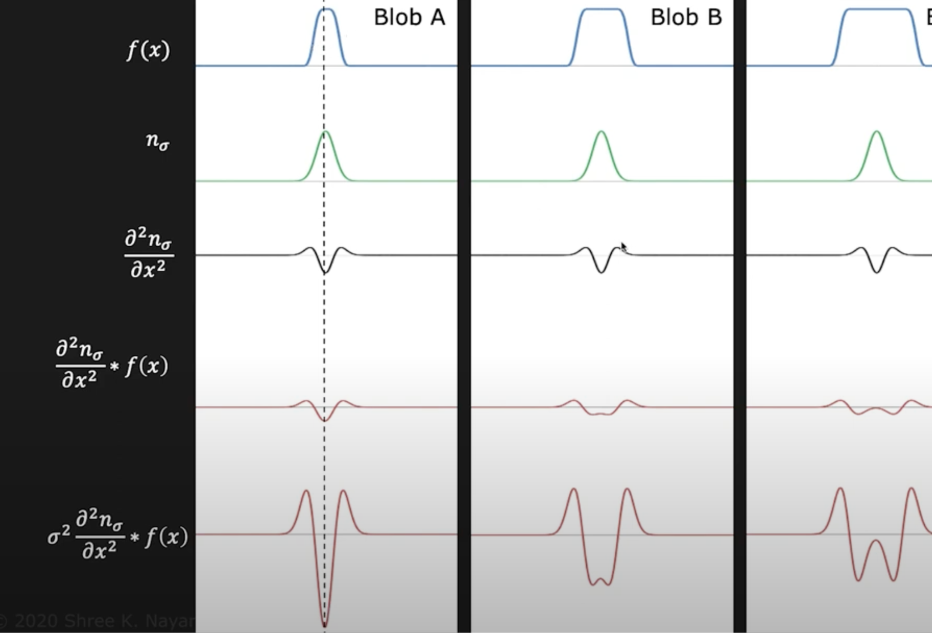
σ normalised
CV 7: Scale Invariant Feature Transform

Slide 33
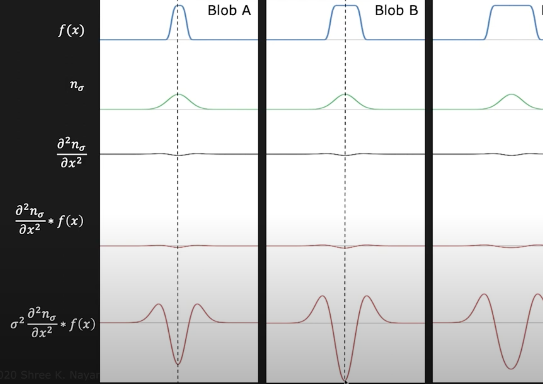
Variation in Scale σ
CV 7: Scale Invariant Feature Transform

Slide 34
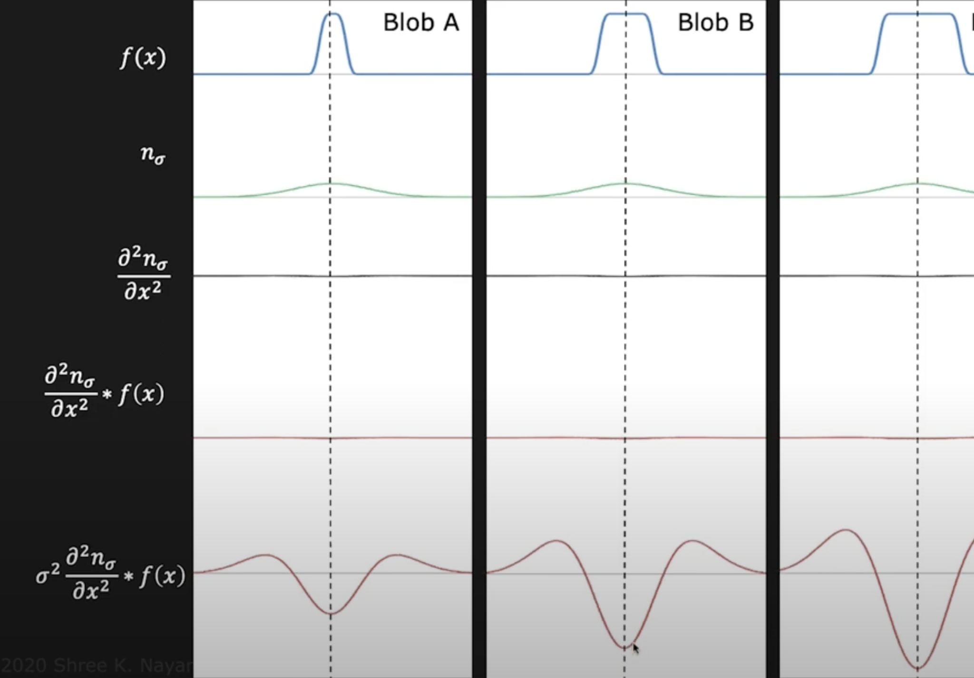
Variation in Scale σ
CV 7: Scale Invariant Feature Transform

Slide 35

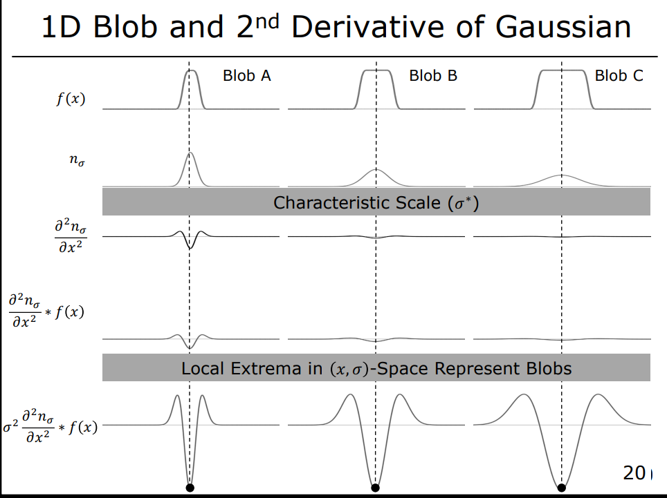

Slide 36
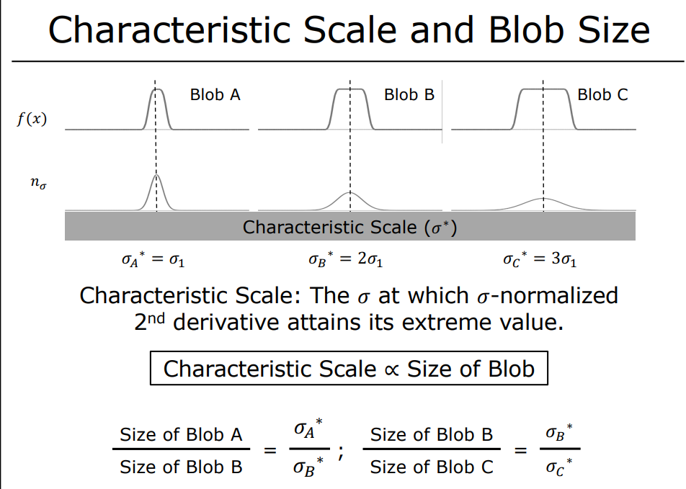

Slide 37
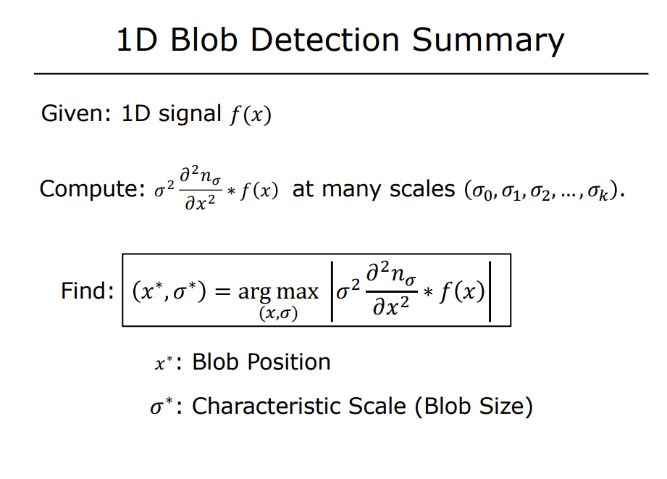

Slide 38
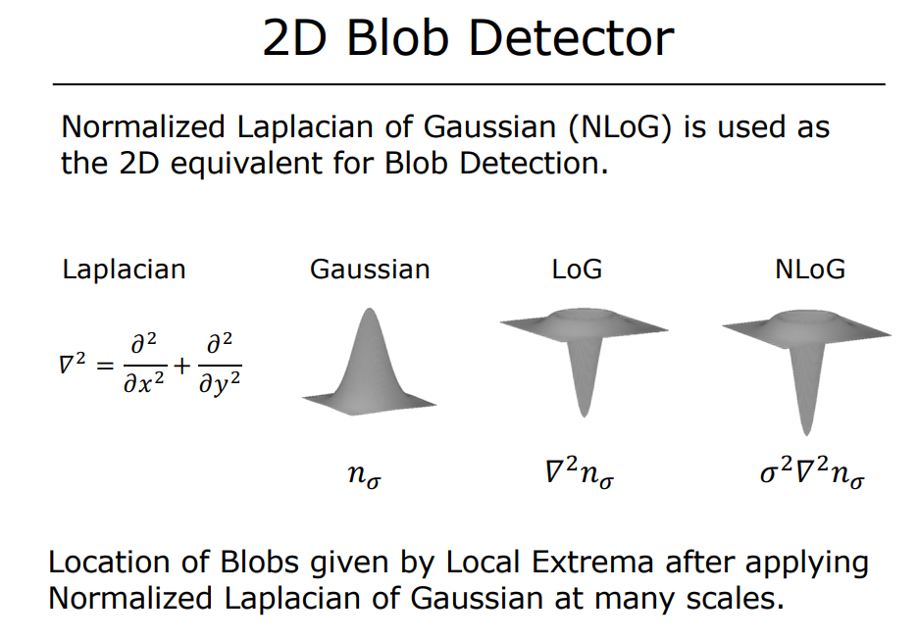

Slide 39
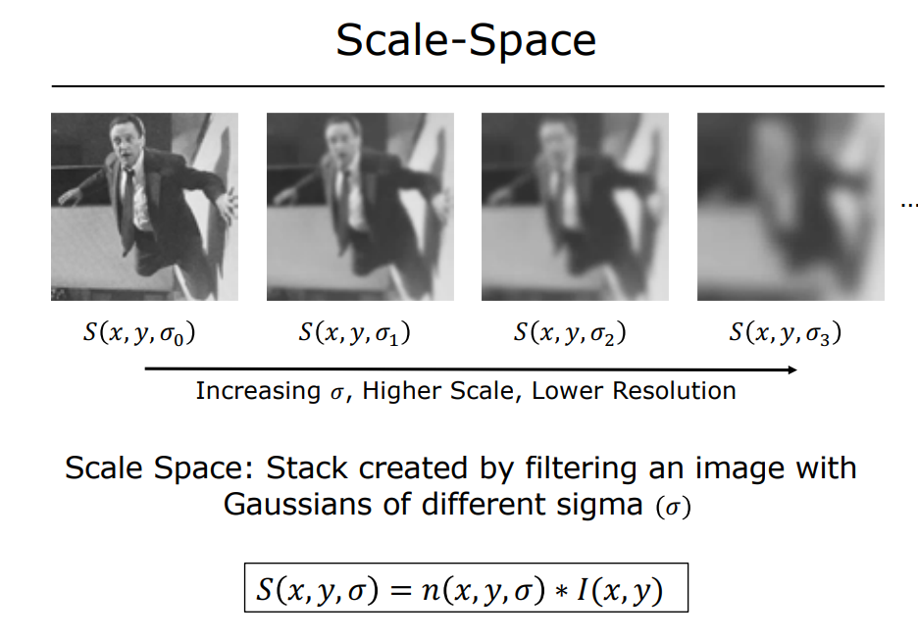

Slide 40
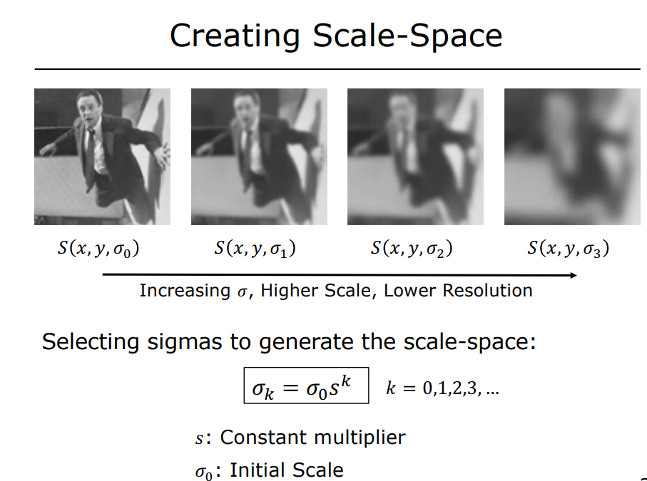

Slide 41
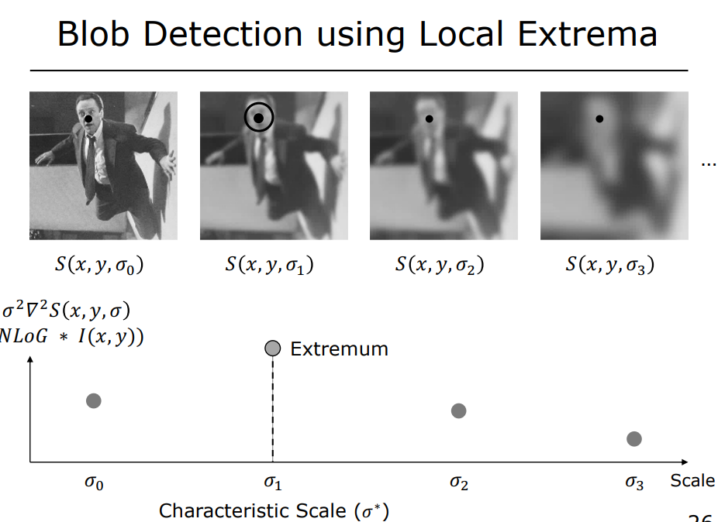

Slide 42
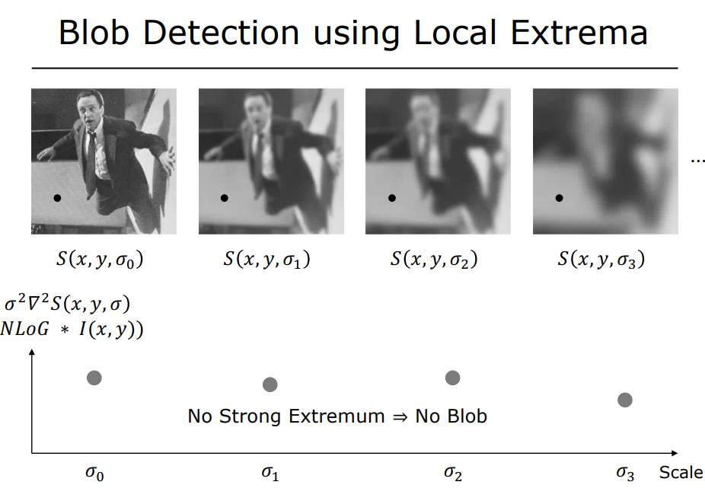

Slide 43
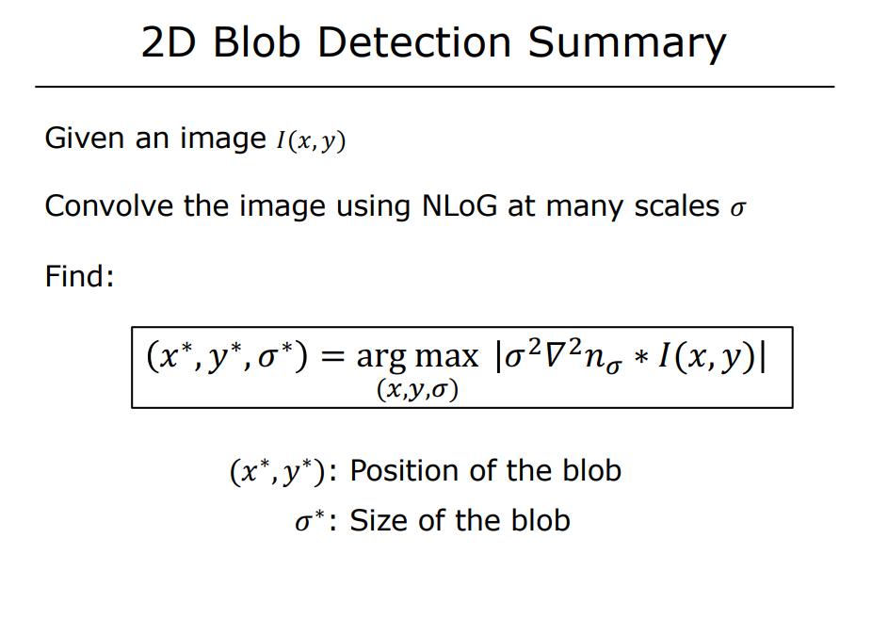

Slide 44
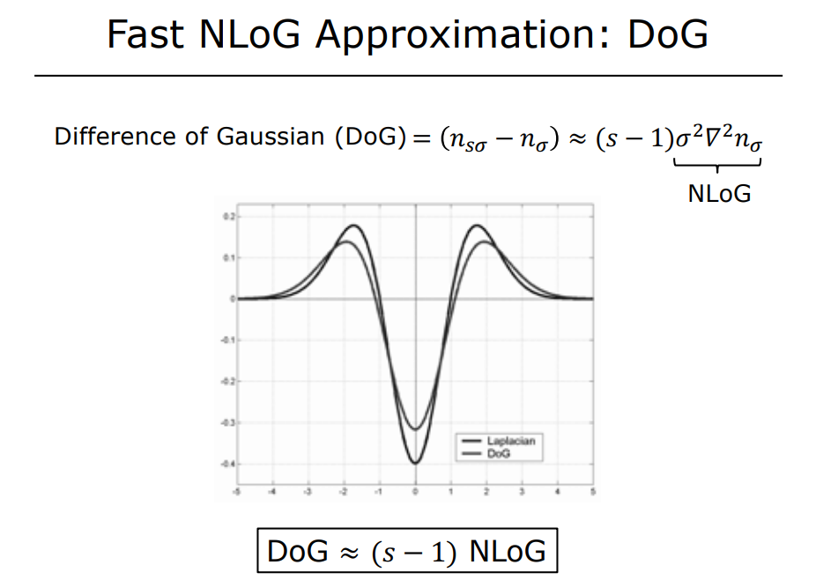

Slide 45
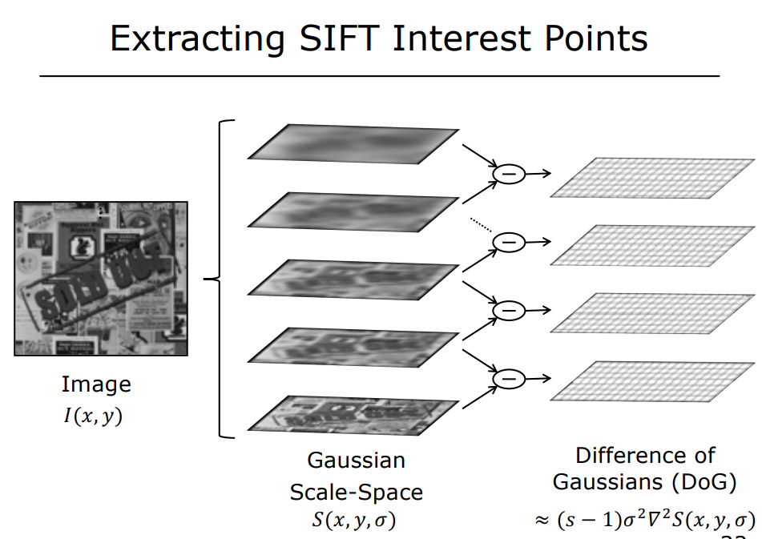

Slide 46
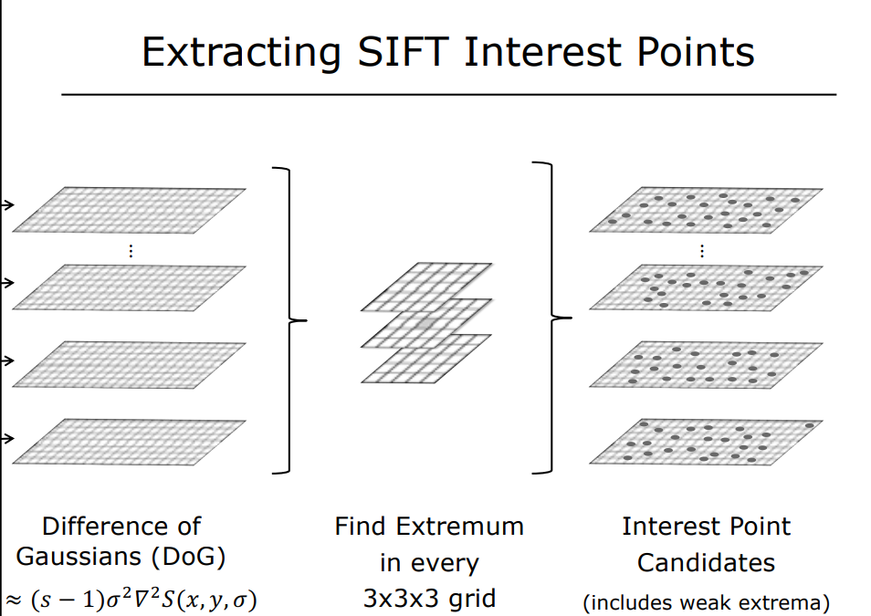

Slide 47
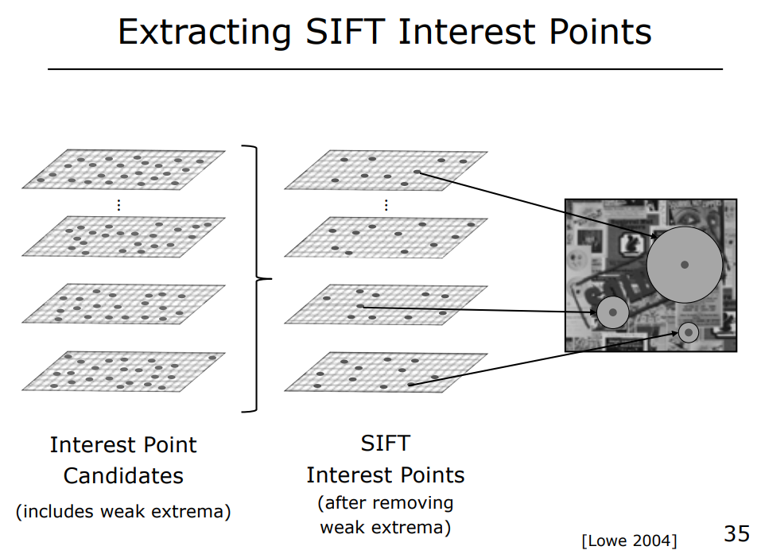

Slide 48
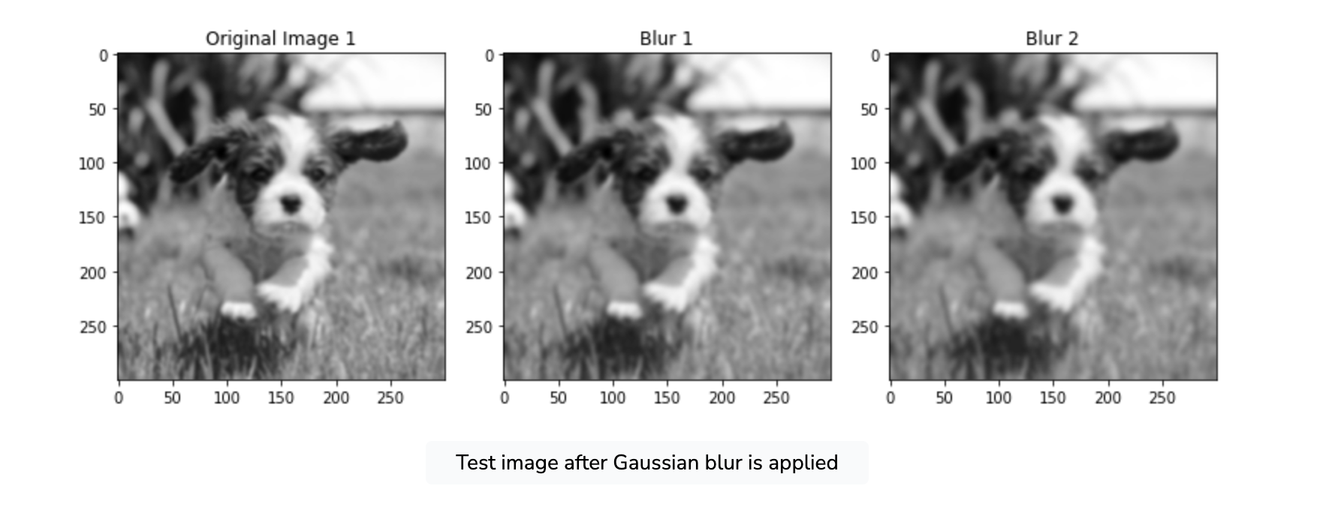
Gaussian Blurring

Slide 49
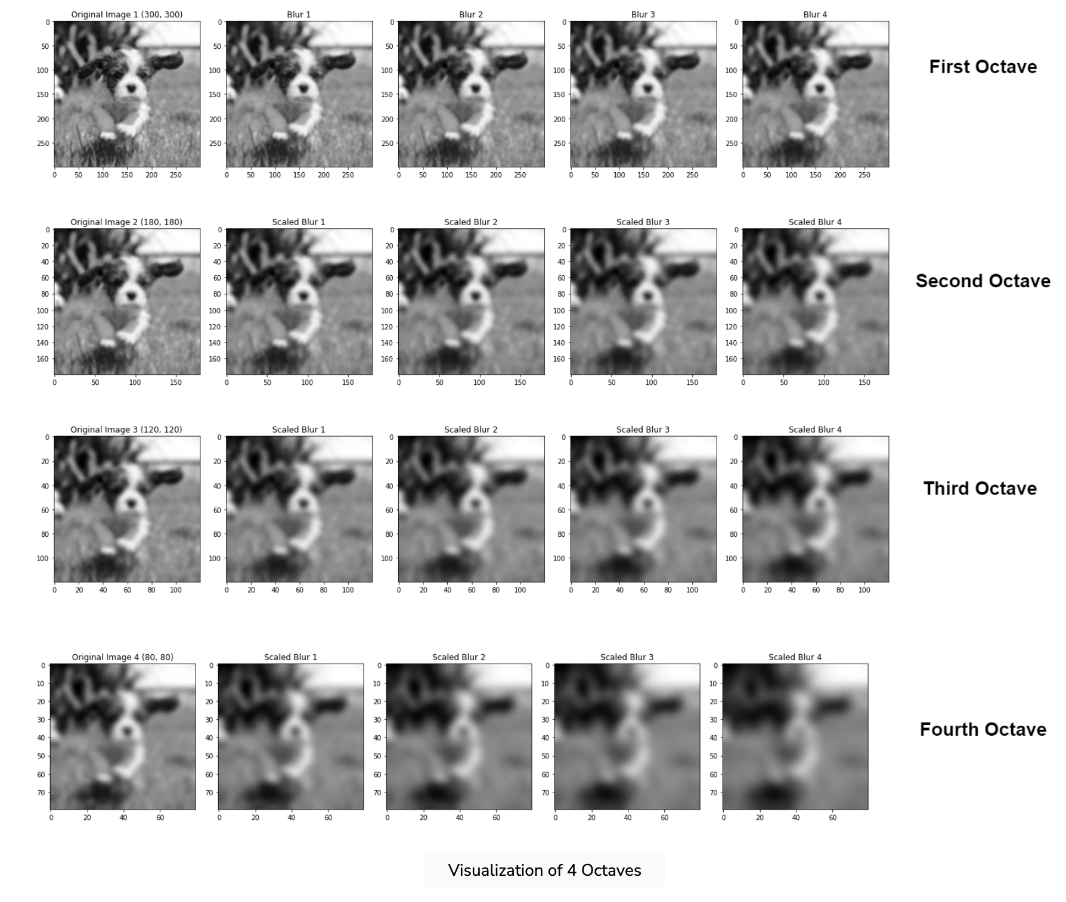
Space Scale
construction
Credits:
https://www.educative.io/answers/what-is-sift

Slide 50
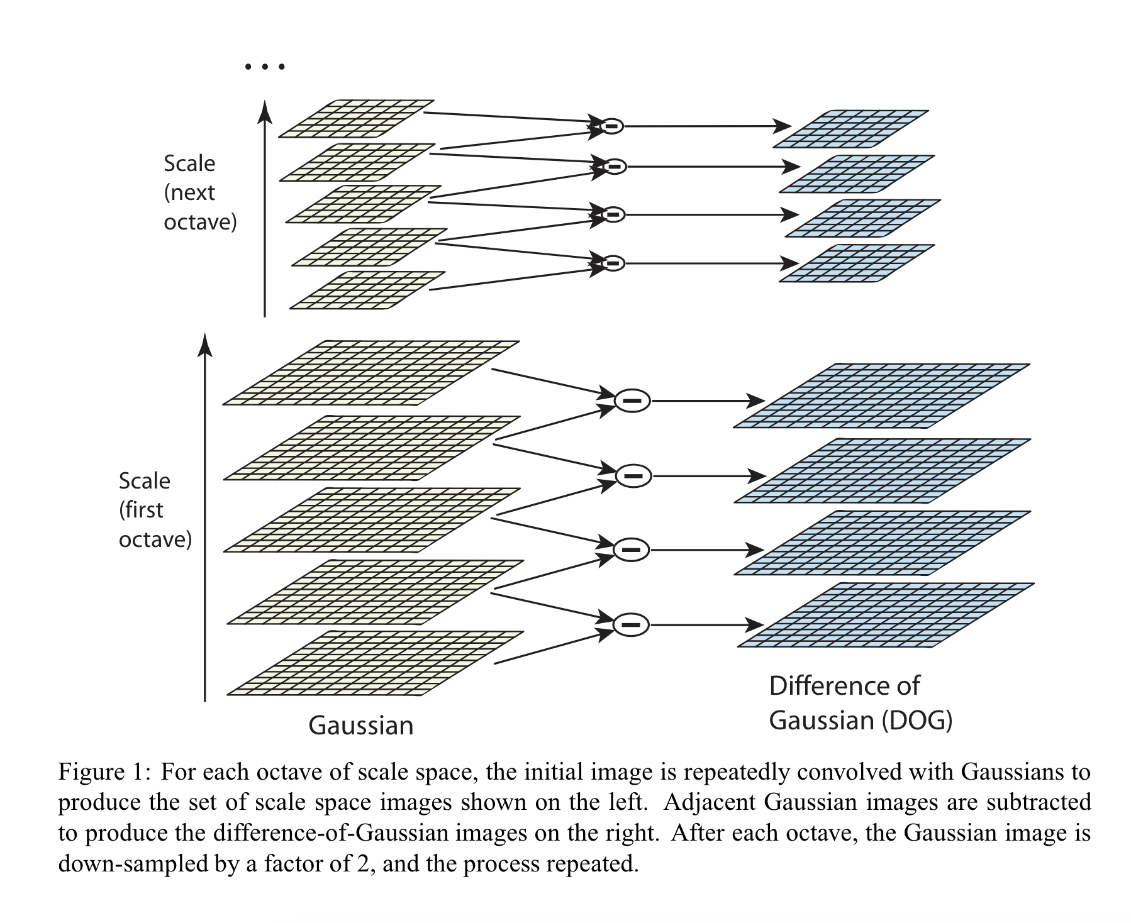
Difference of Gaussian
https://www.cs.ubc.ca/~lowe/papers/ijcv04.pdf

Slide 51
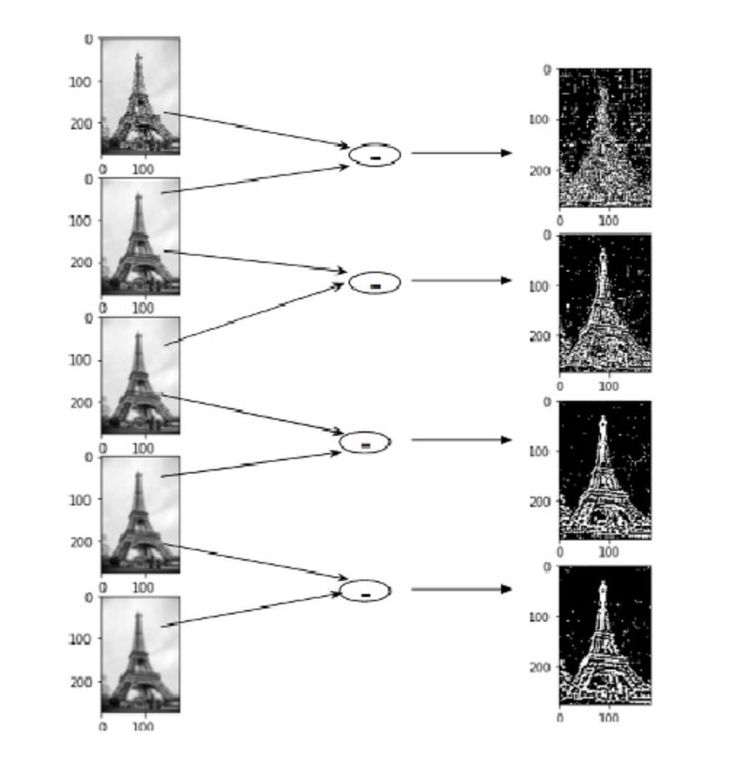
Difference of Gaussians visualisation
https://www.analyticsvidhya.com/blog/2019/10/detailed-guide-powerful-sift-technique-image-matching-python/

Slide 52
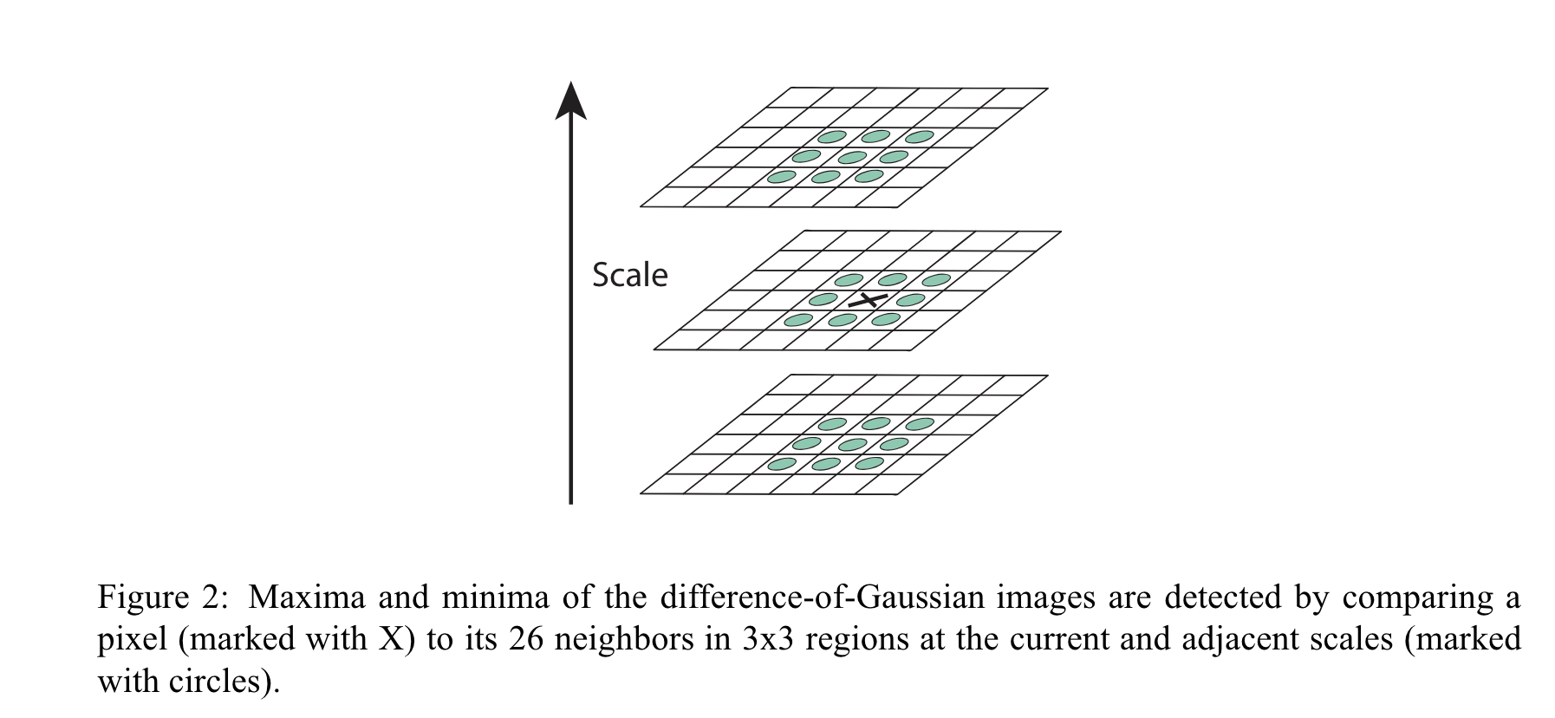
Keypoint localization

Slide 53

Key point descriptor
CV 7: Scale Invariant Feature Transform

Slide 54


Keypoint descriptor
CV 7: Scale Invariant Feature Transform

Slide 55

SIFT descriptor

Slide 56


Slide 57


Slide 58


Slide 59

Scale Invariation

Slide 60


Slide 61


Slide 62

Rotation Invariation using principal orientation

Slide 63


Slide 64


Slide 65


Slide 66


Slide 67


Slide 68


Slide 69


Slide 70


Slide 71


Slide 72


Slide 73
References
https://www.cs.ubc.ca/~lowe/papers/ijcv04.pdf
https://fpcv.cs.columbia.edu/Monographs
Image Processing, Analysis and Machine Vision, Milan Sonka, Vaclav Hlavac, Roger Boyle, 4th Edition, Sections 10.2 and 10.3
https://www.educative.io/answers/what-is-sift
Notebook
https://github.com/mithunkumarsr/LearnComputerVisionWithMithun/blob/main/CV7_SIFT_feature_matching.ipynb

